Slide 3
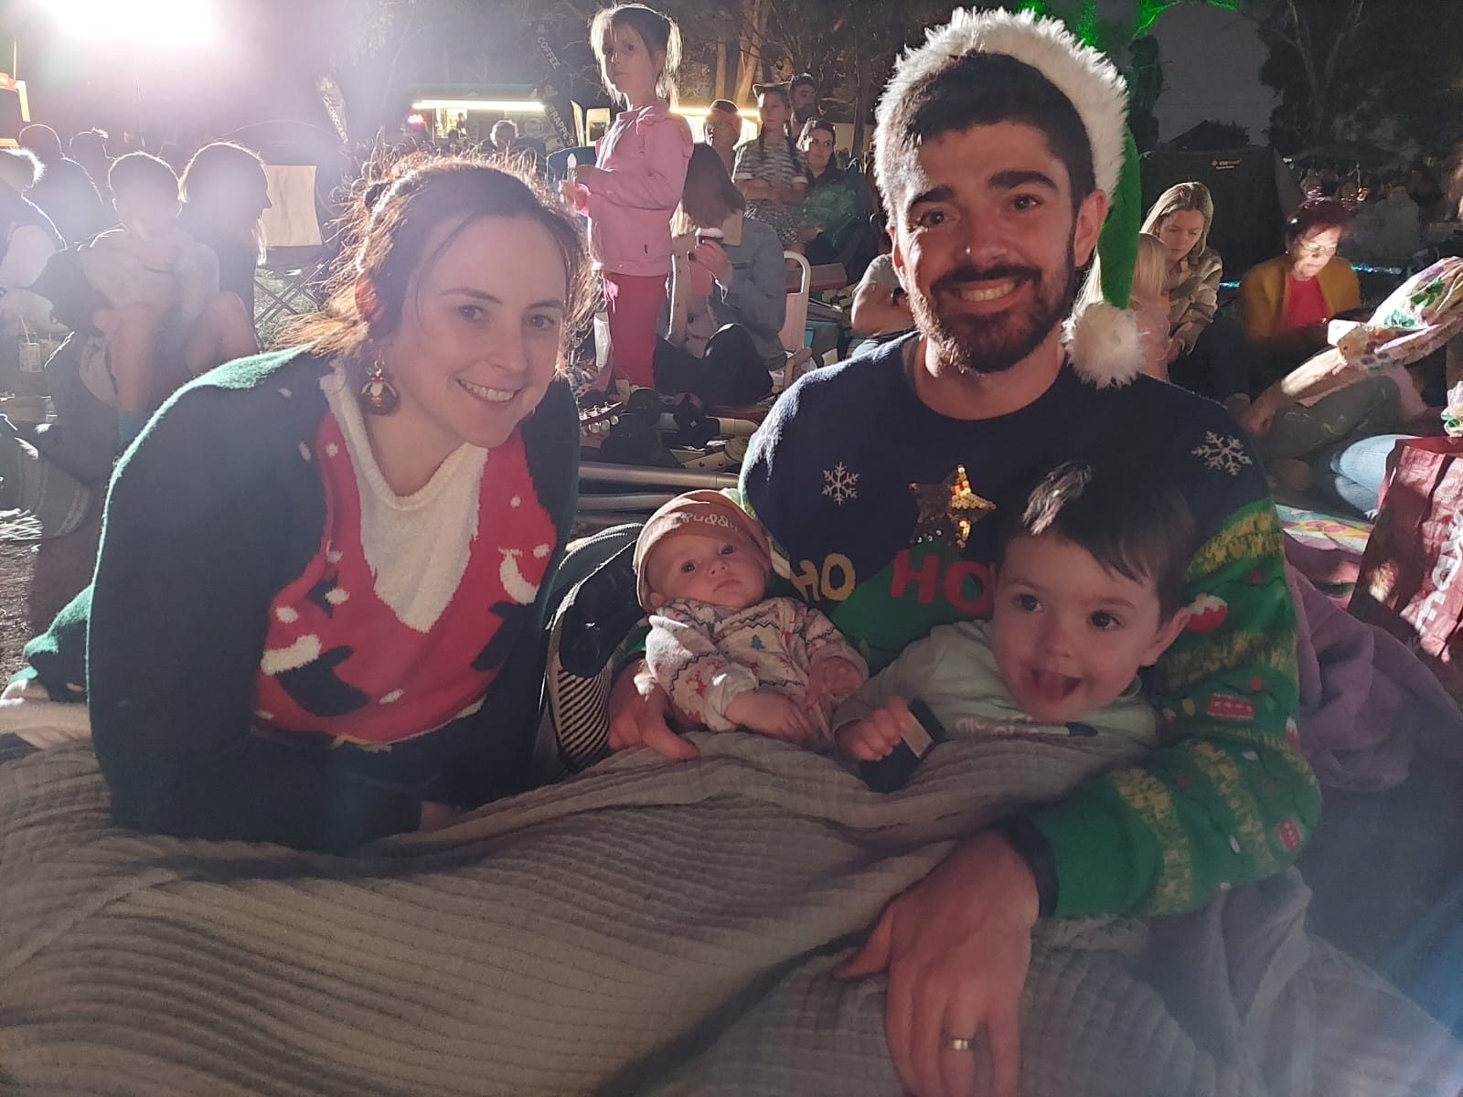
A bit about me …
Family
Husband, Father, Son, Brother
Community
Neighbour, Ringwood Community Church, Friend
Very Average Athlete
Runner
Enjoy following AFL, Basketball, Cricket
Work
Civil Engineer
Worked for state government major road projects

Slide 4
My Journey with God
Grew up in a Christian household attending Catholic Church
Learnt who God is during church and school
During teenage years, spent less time at church and went my own direction
Met Dael and was encouraged to attend Ringwood Community Church
Found Ringwood Community Church as my new home church
Years later, accepted Jesus as my saviour, formed a new relationship with God and was baptised

Slide 5
Today’s Bible Verse: Matthew 28: 19-20 (NIV)
¹⁹ Therefore go and make disciples of all nations, baptizing them in the name of the Father and of the Son and of the Holy Spirit, ²⁰ and teaching them to obey everything I have commanded you. And surely I am with you always, to the very end of the age.

Slide 6
What does Jesus mean by “Therefore go”?
When we accept Jesus as our Saviour, we are transformed.
Romans 6
God says we are salt and the light of the world
God uses us to spread the knowledge of Christ
John 15:16
(As you) Go

Slide 7
Daisy Chain
Office
How does it work?
Write your name in the middle
Label each petal with a social group
List people in the petals who need Jesus
Cafe
Site
Cam
Neighbours
Family
Child Care
Friends
Source: MyFriends Training

Slide 9
A Runner’s Healthy Habits for being a Disciple Maker

Slide 10
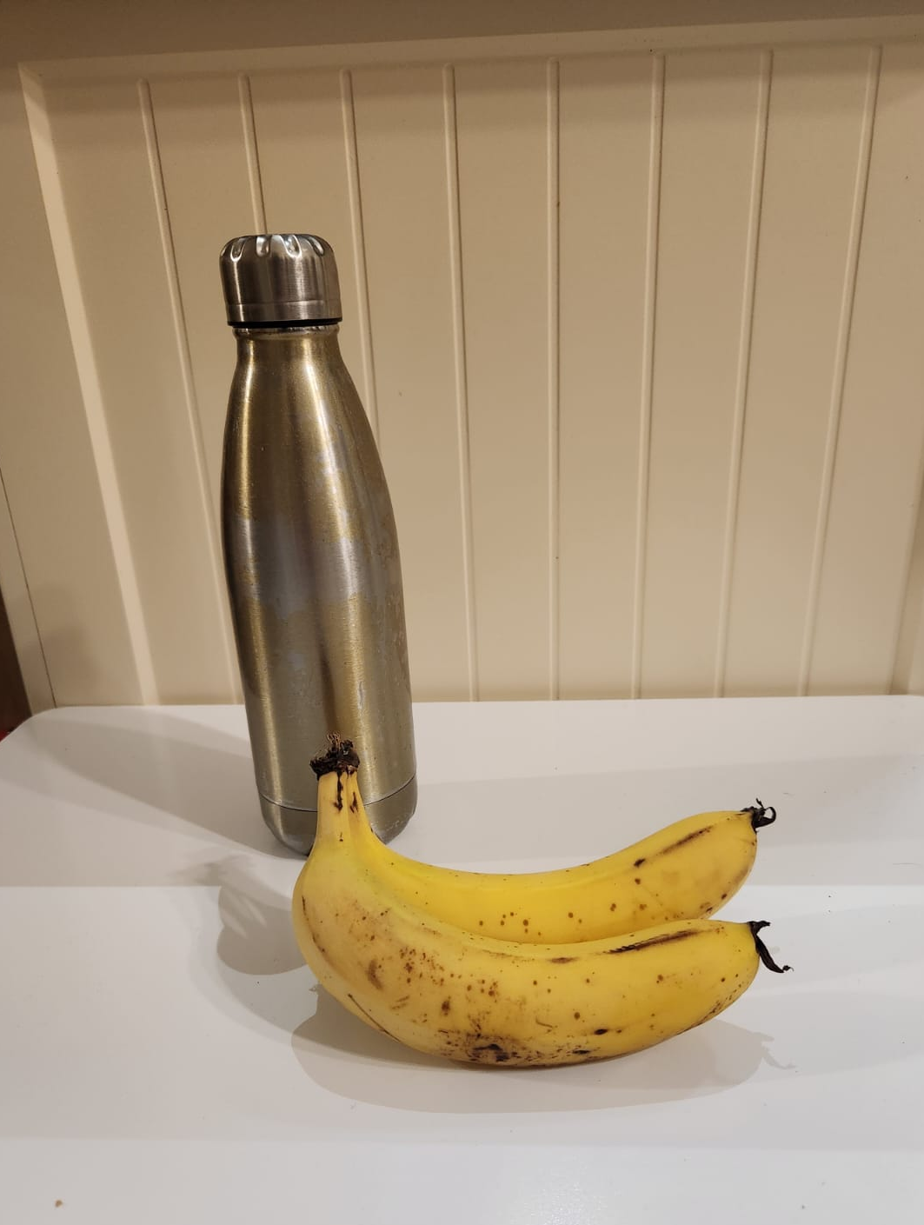
A Runner’s Healthy Habits for being a Disciple Maker
Healthy food and drink represents Studying the Word
We are to Follow Jesus’ teaching and remain connected to Him
John 15:5, Hebrews 2:1
What are you feeding yourself? Eyes, Ears, Thoughts, Rest, Soul

Slide 11
A Runner’s Healthy Habits for being a Disciple Maker
Sturdy pair of runners represents Be prepared for the Long Journey
Living a Christ-like lifestyle daily, building intentional relationships
Philippians 2:5
God wants us to help Him transform hearts, to invite people to Come and See.
1 Corinthians 3:6-7
Reflect on key people who helped you find Jesus

Slide 12
A Runner’s Healthy Habits for being a Disciple Maker
Knee Strap represents Faith and Trust in God
Humble yourself before God and pray to Him
James 1:5, James 4:10
Listen to the Holy Spirit
John 16:13-14
Where do you put your faith when times get tough?

Slide 13
A Runner’s Healthy Habits for being a Disciple Maker
Two pair of runners represents Find a Friend
God wants us to live in community (friend, small group)
Matthew 18:20
Share life, pray with each other and hold each other accountable
James 5:16
Do you have someone who is journeying with you?

Slide 14
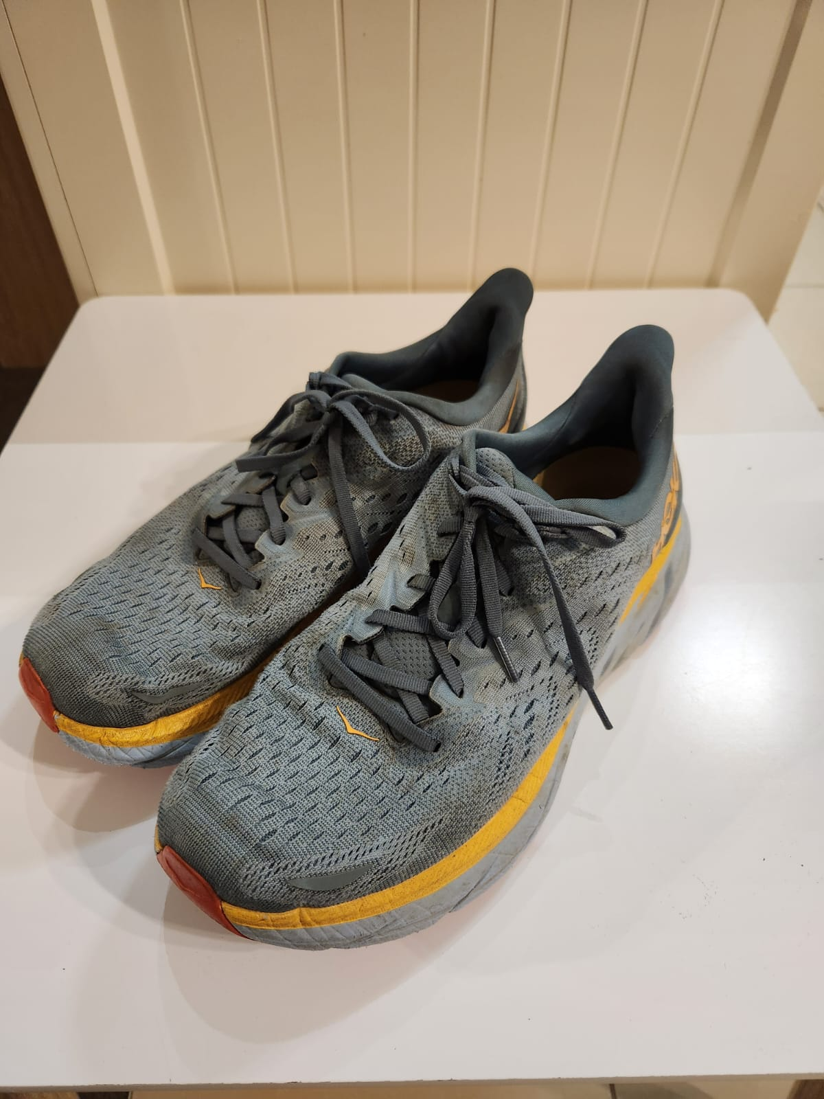
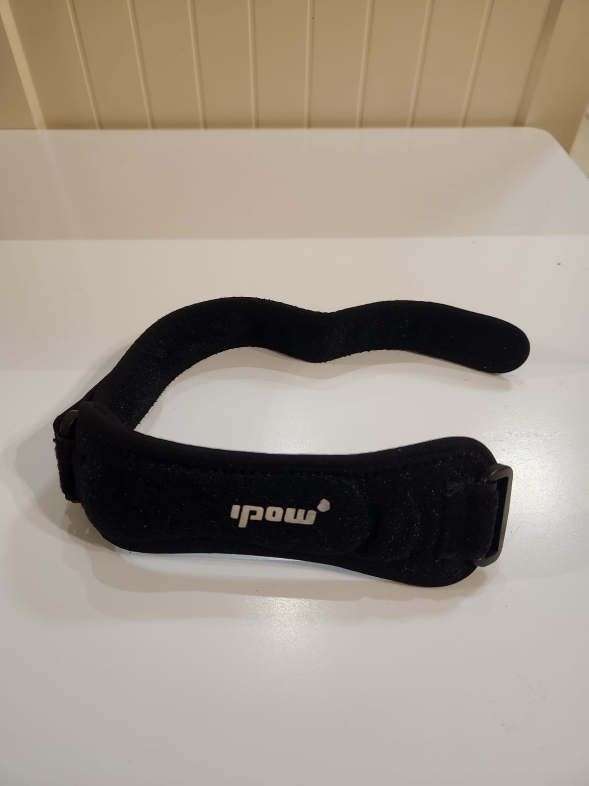
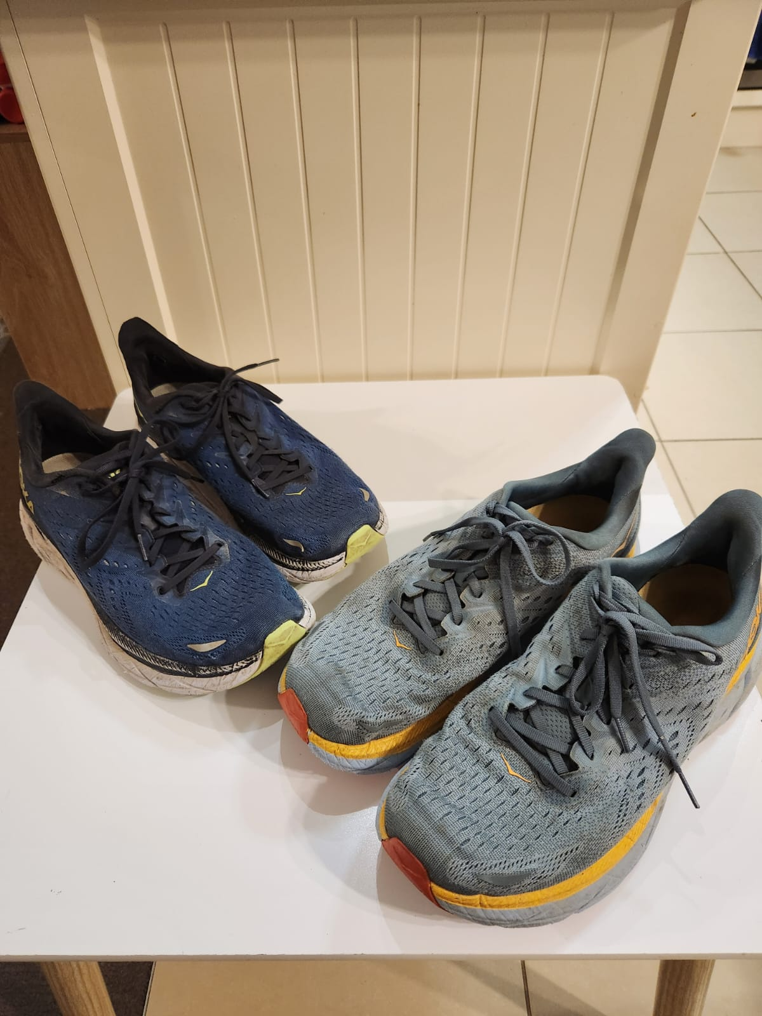
Do you have a “subject to”?
Who needs Jesus in your world?
Studying the Word
Long Journey
Faith and Trust in God
Find a Friend

